Slide 1
Map Reduce 6
ProcessUnits

Slide 2
Reference
https://www.tutorialspoint.com/hadoop/hadoop_mapreduce.htm

Slide 3


Slide 4
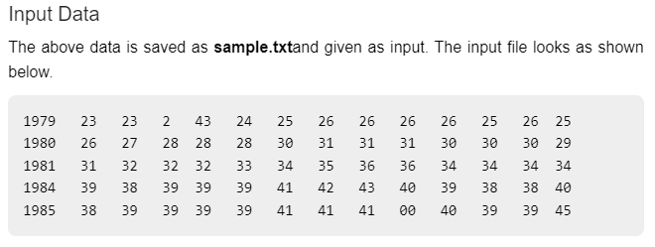

Slide 5
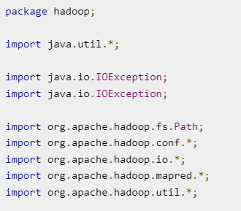
imports

Slide 6
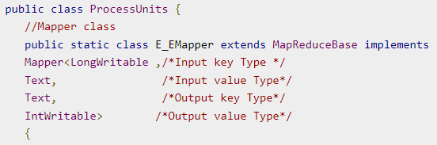
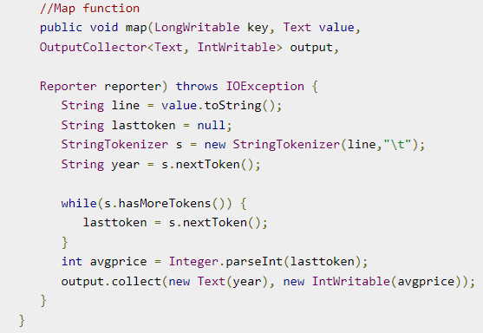

Slide 7
//Reducer class
public static class E_EReduce extends
MapReduceBase implements
Reducer< Text, IntWritable, Text, IntWritable >
{
//Reduce function
public void reduce( Text key, Iterator <IntWritable> values,
OutputCollector<Text, IntWritable> output, Reporter reporter) throws
IOException {
int maxavg = 30;
int val = Integer.MIN_VALUE;
while (values.hasNext())
{ if((val = values.next().get())>maxavg)
{ output.collect(key, new IntWritable(val));
} } } }

Slide 8
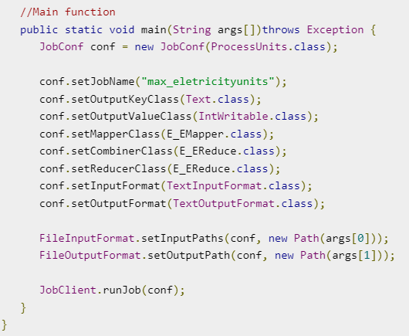

Slide 9
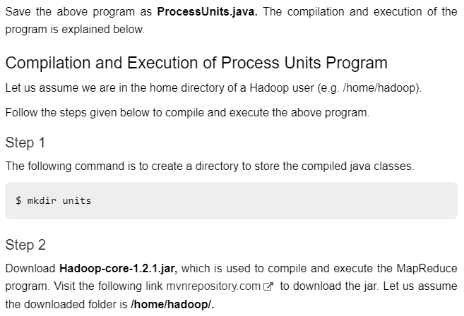

Slide 10
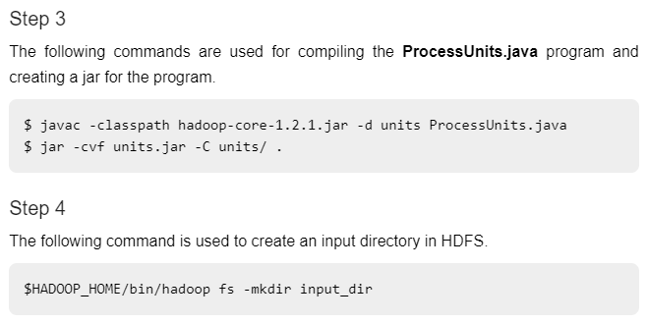
No need to download the jar file, we can use the latest jar file available in hadoop installation. (So dont do step 2).

Slide 11
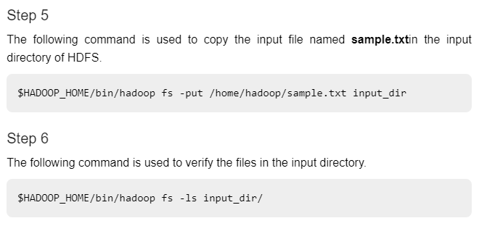
Instead of the first command in step 3, give the following command
javac -d units ProcessUnits.java –cp $(hadoop classpath)
Then continue with other commands

Slide 12
Step 7:
hadoop jar units.jar hadoop.ProcessUnits /input_dir /output_dir

Slide 13
